Slide 1
SynthText: Generating Emotionally Expressive Talking Faces From Image And Text
Amit Bera
Supervisor: Sw. Punyeshwarananda Maharaj

Slide 2
What Is Text-driven Talking Face Generation?
A neural network system that generates talking face videos from a text input.
Instead of relying on speech, text is used to drive lip and facial movements.
Conditions the generated face on a categorical emotion, ensuring that the facial expressions align with the intended emotion.

Slide 3
Why Use Text-driven Generation?
Multilingual Support: Enables use in environments where different languages or dialects are spoken but can be transcribed.
Silent Communication: Useful in situations where audio communication is not feasible.
Accessibility: Can be adapted for the hearing-impaired, who might rely more on text-based communication.
Emotion Personalization: Enhances human-computer interaction with more personalized and emotion-expressive avatars.

Slide 4
How Does The System Work?
Input:
Text Input: The user provides a text sentence.
Emotion Condition: The user selects an emotion category (e.g., happiness, sadness).
Image Input: A reference face image is supplied.
Output: A video of the face speaking the provided text, with facial expressions matching the chosen emotion.

Slide 5
Literature Review I
Overview of Talking Face Generation:
Text-Driven Approaches:
Suwajanakorn et al. (2017): Developed a system using LSTMs to predict facial landmarks from phonetic and timing information derived from text.
Limitation: Restricted to a single speaker and required extensive datasets.
Speech-Driven Approaches:
Zhou et al. (2019): Introduced a GAN-based method that used temporal loss to ensure smooth lip synchronization across frames.
Vougioukas et al. (2018): Proposed a temporal GAN framework for enhanced realism, temporal continuity, and audio-visual synchronization.

Slide 6
Literature Review II
End-to-End vs. Landmark-Based Systems:
Landmark-Based Systems:
Chen et al. (2019): A two-stage system: LSTM predicted facial landmarks, and GANs synthesized high-quality video.
Zakharov et al. (2019): Improved landmark-to-image conversion using style-based GANs but faced issues with identity mismatches in videos.
End-to-End Systems:
Eskimez et al. (2021): Proposed an end-to-end system with frame and pair discriminators, improving lip synchronization and video quality using Mouth Region Mask (MRM) loss.

Slide 7
Literature Review III
Emotion Models in Talking Face Systems:
Emotion Representation Models:
Categorical Models: Classify emotions into distinct categories like happiness, sadness, and anger (Ekman, 1972).
Dimensional Models: Use scales like arousal-valence to describe emotions in a more nuanced way (Lewis et al., 2007).
Emotionally Expressive Systems:
ExprGAN (Ding et al., 2017): Allowed continuous control over expression intensity, making synthesized videos more expressive.
Fang et al. (2022): Enforced emotional congruence between speech and video but struggled with visual artifacts like pixel jittering.

Slide 8
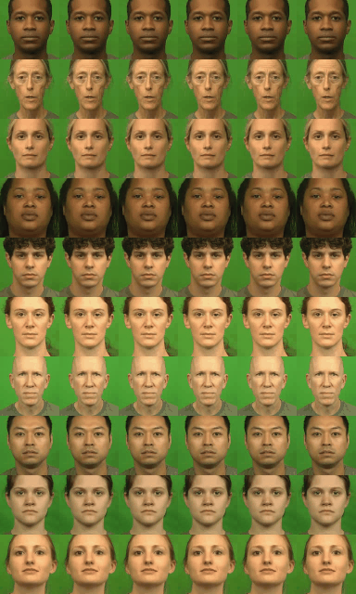
Dataset
Link: CREMA-D
Overview:
Actors: 91 actors (48 male, 43 female), aged 20-74.
Emotions: 6 categories(Anger, Disgust, Fear, Happiness, Neutral, Sadness) with 4 emotion level (Low, Medium, High, Unspecified).
Data: 7,442 video clips featuring actors expressing one of 12 sentences in different emotional tones.
Resolution: 480x360, 30 FPS video clips, audio sampled at 44.1 kHz.

Slide 9


Workflow I
1. Data Processing:
(i) Downsampled to 25 FPS and 8 kHz audio.
Original Video
25 FPS Converted Video

Slide 10
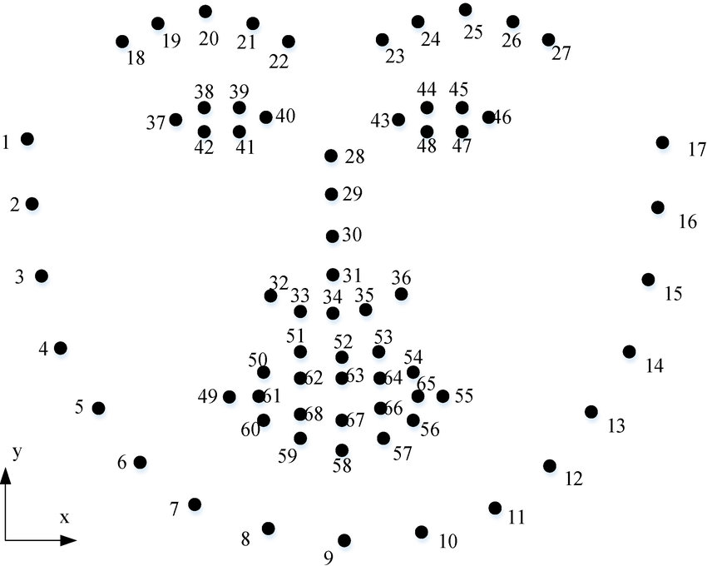
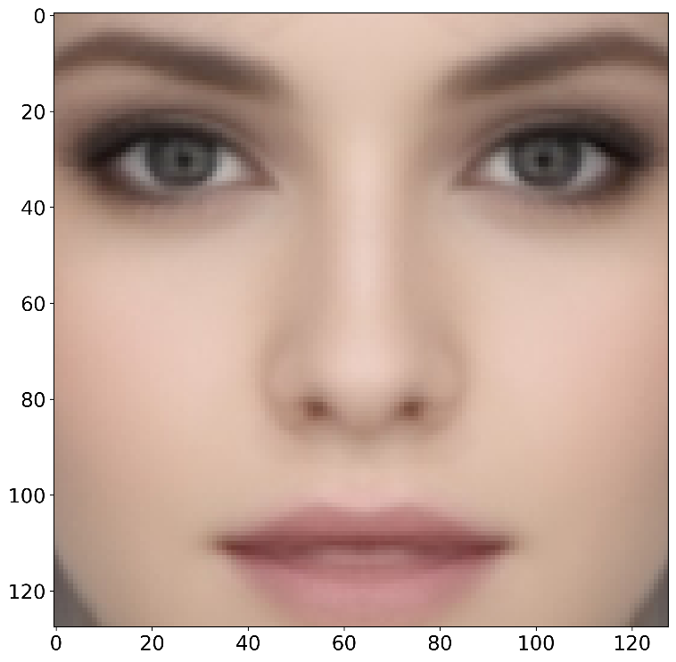
Workflow II
1. Data Processing:
(ii) Face alignment using landmarks.

Slide 11
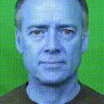
Workflow III
2. Data Augmentation:
Brightness, contrast, noise, and color adjustments using Albumentations.
25 FPS Converted Video
Processed hdf5 file

Slide 12
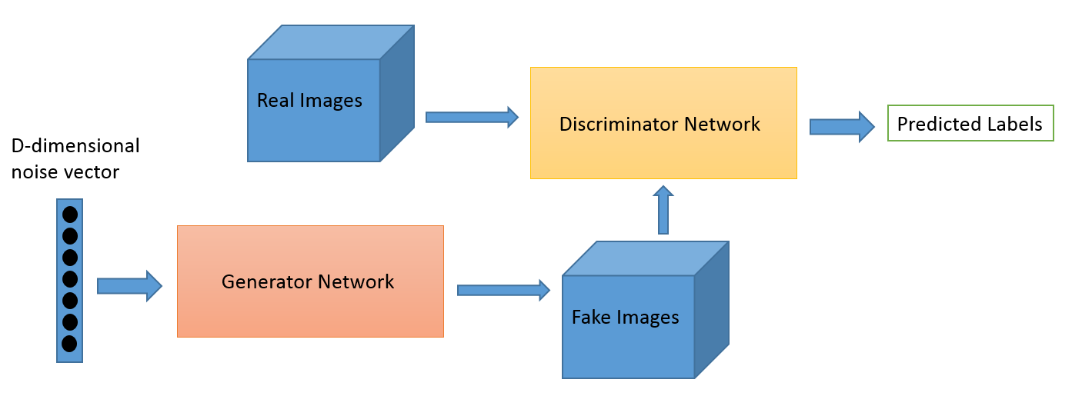
Workflow IV
3. Model Building:
GAN – A deep learning model with 2 networks:
Generator (G): Tries to create realistic data from random noise.
Discriminator (D): Distinguishes between real data and generated data.

Slide 13
Model Architecture I
1. Inputs:
Reference Image: A single facial image provides the identity for the generated talking face.
Speech Waveform: The primary driver for generating lip movements.
Categorical Emotion Label: A one-hot encoded vector representing the emotion (e.g., happy, sad, neutral).
Random Noise Vector: A 128-dimensional Gaussian noise vector adds variation and robustness.

Slide 14
Model Architecture II
2. Encoders: Each encoder processes a specific type of input and outputs a feature embedding.
(a) Speech Encoder: Processes raw speech waveforms into a speech embedding.
Architecture:
5 1D convolutional layers with filters, kernel sizes, and strides:
(64, 63, 4), (128, 31, 4), (256, 17, 2), (512, 9, 2), (16, 1, 1).
Activations: LeakyReLU with slope = 0.2.
Fully connected and LSTM layers refine the temporal structure.
Output: Time-aligned speech features (25 vectors per second).

Slide 15
Model Architecture III
(b) Image Encoder: Encodes the facial identity from a single input image.
Architecture:
6 2D convolutional layers with downsampling using strides:
(64, 3, 2), (128, 3, 2), (256, 3, 2), (512, 3, 2), (512, 3, 2), (512, 4, 1).
Skip connections (U-Net style) to enhance spatial resolution during decoding.
Output: Multi-scale image embeddings.
(c) Emotion Encoder: Encodes categorical emotions into an emotion embedding vector.
Architecture:
Two fully connected layers with LeakyReLU activations.
Input: One-hot vector for six emotion categories (happiness, sadness, anger, fear, disgust, neutral).
Output: Low-dimensional embedding for emotion conditioning

Slide 16
Model Architecture IV
(d) Noise Encoder: Processes Gaussian noise to introduce variability and prevent overfitting.
Architecture:
Single LSTM layer to ensure temporal consistency.
Output: Noise embedding sequence.
3. Decoder: The decoder combines outputs from all encoders to generate video frames.
Input Concatenation: Speech, image, noise, and emotion embeddings are concatenated.

Slide 17
Model Architecture V
4. Discriminators: Two discriminators are used to guide the GAN training process.
(a) Frame Discriminator: Evaluates individual frames for image quality and consistency of facial identity.
Architecture:
5 convolutional layers (2D) followed by fully connected layers.
Outputs a real or fake score for each frame.
(b) Emotion Discriminator: Ensures the generated video accurately conveys the intended emotion.
Architecture:
Processes frames using the same structure as the frame discriminator.
Incorporates an LSTM to analyze temporal emotion consistency.
Outputs probabilities for six emotion classes and one "fake" class.

Slide 18
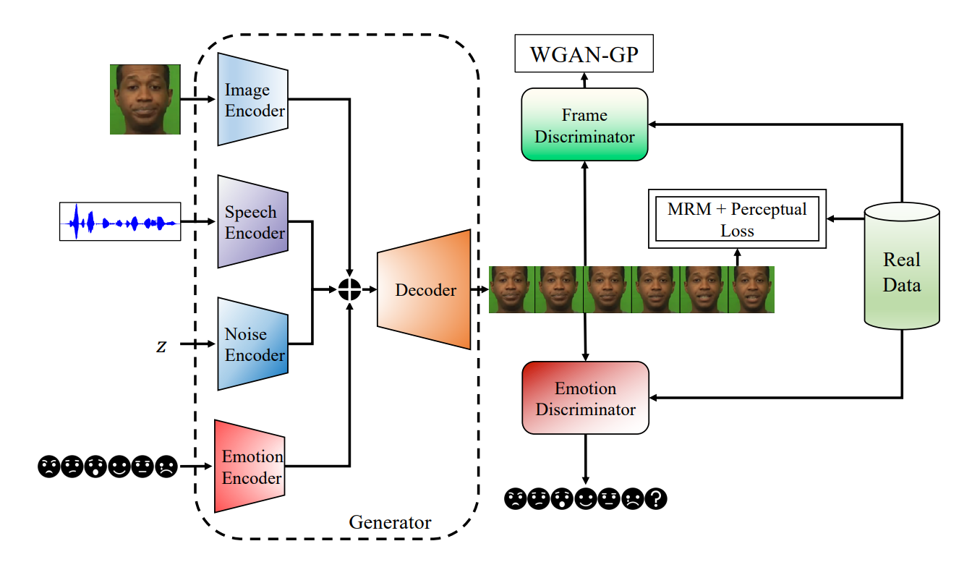
Model Architecture VI

Slide 19

Model Architecture VI
Text-to-Speech Model:
Generates the audio waveform corresponding to the input text.
Google Text-to-Speech (gTTS) is used in this system for speech synthesis.

Slide 20
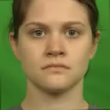

Results
Generated Speech (text from dataset) + Sample Image
Image (dataset)
Image (outside)

Slide 21


Results
Generated Speech (all text from dataset) + Image (datset)
Neutral Emotion
Happy Emotion

Slide 22
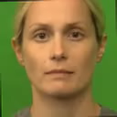
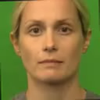
Results
Generated Speech (different language) + Image (dataset)
Neutral Emotion
Happy Emotion

Slide 23
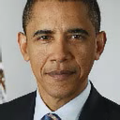
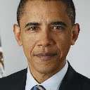
Results
Generated Speech (different language) +
Image (outside dataset)
Neutral Emotion
Happy Emotion

Slide 24
Future Work
Add more detailed emotion options to make expressions even better.
Make the system work well with noisy audio and images.
Ensure smooth transitions in videos over time.
Use more data types (like heart rate) for richer emotions.
Create personalized talking faces for each user.
Develop tools to prevent misuse of the technology.

Slide 25
Thank you
AMIT BERA
B2330056
beraamit8171@gmail.com

